Slide 1
Evolution Of Management Thought

Slide 2
Learning Outcome
Able to understand that how the concept of management evolved.
Able to understand different approaches of management.

Slide 3
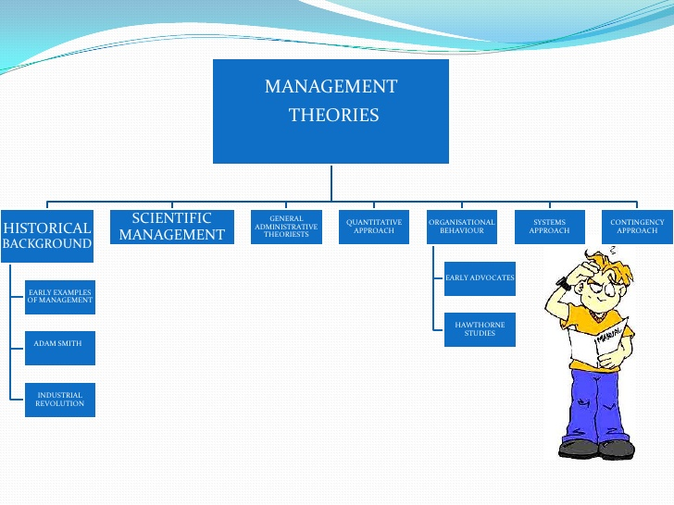

Slide 4
HISTORICAL BACKGROUND OF MANAGEMENT
The Egyptian pyramids and the Great Wall of China are good examples of projects of tremendous scope and magnitude that employed tens of thousands of people. How was it possible for these projects to be completed? The answer is management.
Other examples of early management practices can be seen through assembly lines, accounting systems, and personnel functions as just a few of the processes and activities in organizations at that time that are also common to today’s organizations.

Slide 5
Adam Smith, author of the classical economics doctrine, The Wealth of Nations, argued brilliantly about the economic advantages that division of labor would bring to organizations and society.
The Industrial Revolution can be thought of as possibly the most important pre-twentieth-century influence on management. The introduction of machine powers, combined with the division of labor, made large, efficient factories possible. Planning, organizing, leading, and controlling became necessary.

Slide 6
The Evolution of Management Theories
Management is a very old concept. Generally, though, we think of “modern management” and the specific identification of planning, organizing, leading, and controlling being the functions of management as having begun at the end of the 1800s. Most of the contributors we recognize today have been twentieth century people.

Slide 7
CLASSICAL VIEW OF MANAGEMENT
Classical Viewpoint is divided into three parts:
1.Scientific management
2.Bureaucratic management
3. Administrative management

Slide 8
Scientific Method
The use of the scientific method to define the “one best way” for a job to be done.
Frederick W. Taylor is known as the “Father of scientific management.”
The first nationally known management thinker. His “Taylorism” or “Scientific management” was a major contribution to business operations.

Slide 9
Taylor developed scientific management to counter the problem of soldiering by workers.
Taylor pioneered the time-and-motion study.
Through his four principles of scientific management, he advocated scientific study of the task to find the best work method rather than relying on traditional methods.
Taylor successfully implemented his theory at Bethlehem Steel in two famous studies involving shoveling and pig-iron handling.

Slide 10
Taylor’s Four Principles
Replace rule-of-thumb with science.
Harmony not discord
Co-operation not individualism
Development of each and every worker to his greater efficiency

Slide 11
Key Features of scientific management
Separation of planning and execution functions
Scientific wage allocation
Scientific structuring of task
Scientific categorization across work, methods, motion and time study
Standardization of work
Scientific selection and training
Pay incentives
Economy
Mindset transformation

Slide 12
Bureaucratic Management
Scientific management focused on the work or the job and how to do it better.
Bureaucratic Management focused on how to structure the organization better so that better overall performance might be achieved.
Max Weber was the main author for this thought.

Slide 13
Characteristics Of Weber’s Bureaucracy
Specialization of a labor
Formalization of rules and procedures
Formalization of lines of authority into a hierarchical structure
Formalization of the career advancement process to be based on merit
Impartial assessment

Slide 14
ADMINISTRATIVE VIEW OF MANAGEMENT
It is a term used for those early-day contributors who developed and taught principles to be used by managers, both individually and collectively, to improve the performance of the overall functions of the organization.
Henri Fayol (1841-1925) a successful French industrialist, developed theories about management he thought could be taught to those individuals with administrative responsibilities.

Slide 15
Fayol’s 14 Principles of Management
1. Division of work: Specialization increases output by making employees more efficient.
2. Authority: Managers must be able to give order. Authority gives them this right. Along with authority, however, goes responsibility.
3. Discipline: Employees must obey and respect the rules that govern the organization.
4. Unity of Command: An employee should receive orders from one superior only.

Slide 16
5. Unity of direction: The organization should have a single plan of action to guide managers and workers.
6. Subordination of individual interests to the general interest: The interests of any one employee or group of employees should not take precedence over the interests of the organization as a whole.
7. Remuneration: Workers must be paid a fair wage for their services.
8.Centralization & Decentralization: This term refers to the degree to which top management and sub-ordinates are involved in decision making.
9.Scalar Chain: It refers the chain of supervisors from top to bottom within an organization and communication flow should happen via the scalar chain.

Slide 17
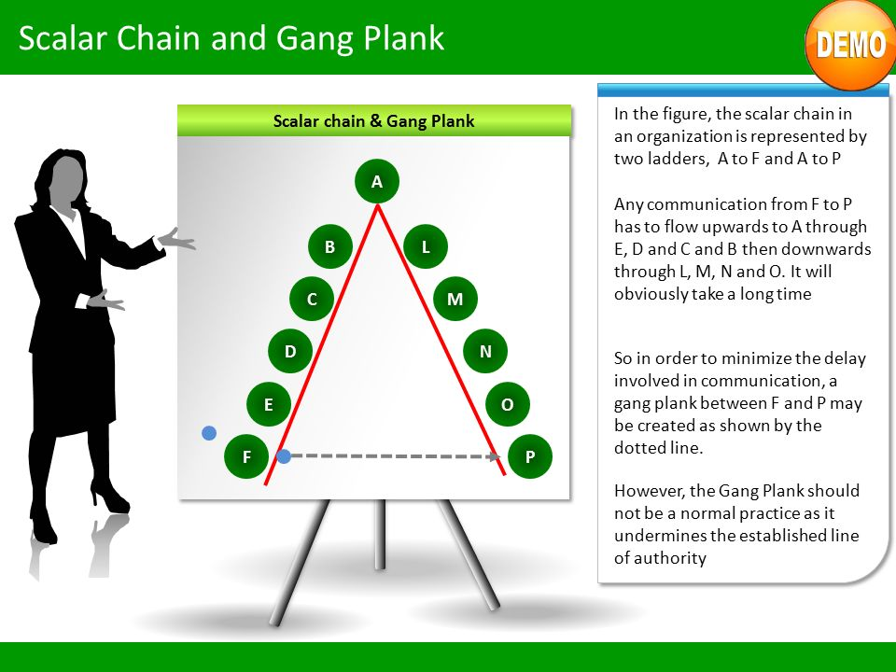

Slide 18
10.Order: People and materials should be in the right place at the right time.
11.Equity: Managers should be kind and fair to their subordinates.
12.Stability of tenure of personnel: Management should provide orderly personnel planning and ensure that replacements are available to fill vacancies.
13.Initiative: Employees who are allowed to originate and carry out plans will exert high levels of effort.
14.Esprit de corps: Promoting team spirit will build harmony and unity within the organization.

Slide 19
Similarity between “Taylorism” & “Fayolism”
Both have attempted to overcome managerial problems in a systematic way.
Both have emphasized that management actions can be effective if these are based on sound principles.
Both have emphasized harmonious relationship between management and workers for the achievement of organizational objectives.

Slide 20
“Taylorism” V/S “Fayolism”
Basis of difference | Taylorism | Fayolism
Perspective | Shop floor level | Higher management level
Focus | Efficiency through work simplification and standardization | Efficiency by observing certain principles
Orientation | Production and engineering | Managerial functions
Results | Scientific observation and measurement | Personal experiences translated into universal truths

Slide 21
HAWTHORNE STUDY & HUMAN RELATIONS
INTRODUCTION
The Hawthorne studies were conducted in order to find out the role of human resource in increasing the production of an organization.

Slide 22
HAWTHORNE EXPERIMENT
Conducted between 1924-1932
Conducted at WESTERN ELECTRIC COMPANY, Hawthorne Plant, Chicago, USA
Conducted by,
Elton Mayo (Psychologist)
White Head (Sociologist)
Roethlisberger (Sociologist)
William Dickson (Company Representative)
The Hawthorne studies included the following experiments…

Slide 23
George Elton Mayo
He was an Australian Psychologist.
Lectured at University of Queensland before moving to the University of Pennsylvania
Spent most of his career at Harvard Business School and was the Professor of Industrial Research
Known as the founder of Human Relations Movement
Also known for his research including Hawthorne Studies

Slide 24
Experiments Conducted
Illumination Experiment (1924-1927)
Relay Assembly Test Experiments (1927-1928)
Mass Interview Group (1928-1930)
Bank Wiring Observation Group (1931-1932)

Slide 25
Illumination Experiments (1924-27)
These experiments were performed to find out the effect of different levels of illumination (lighting) on productivity of labor. The brightness of the light was increased and decreased to find out the effect on the productivity of the test group. Surprisingly, when the intensity of illumination was decreased the production continued to increase in both the group. The production in the experimental group decreased was due to light falling much below the normal level. Thus, it was concluded that illumination did not have any effect on productivity but something else interfering with the productivity.

Slide 26
Relay Assembly Test Room Study (1927-1929)
Under these test two small groups of six female telephone relay assemblers were selected. Each group was kept in separate rooms. From time to time, changes were made in working hours, rest periods, lunch breaks, etc. They were allowed to choose their own rest periods and to give suggestions. Output increased in both the control rooms. It was concluded that social relationship among workers, participation in decision-making, etc. had a greater effect on productivity than working conditions.

Slide 27
Changes And Resultant Outcome of Relay Room Experiment
The incentive system was changed so that each girl’s extra pay was based on the other five rather than output of larger group. Productivity increased as compared to before.
Two-five minutes rest-one in morning and other in evening session were introduced which were increased to ten minutes. Productivity increased.
The rest period was reduced to five minutes but frequency was increased. The productivity decreased slightly and girls complained that frequent rest intervals affected the rhythm of the work.
Morning coffee or soup along with sandwich and evening snack was also provided. Productivity increased.
Changes in working hours and workday were introduced. Productivity increased.

Slide 28
Mass Interviewing Program (1928-1930)
21,000 employees were interviewed over a period of three years to find out reasons for increased productivity. It was concluded that productivity can be increased if workers are allowed to talk freely about matters that are important to them.

Slide 29
Bank Wiring Observation Room Experiment (1932)
A group of 14 male workers in the bank wiring room were placed under observation for six months. A worker's pay depended on the performance of the group as a whole. The researchers thought that the efficient workers would put pressure on the less efficient workers to complete the work. However, it was found that the group established its own standards of output, and social pressure was used to achieve the standards of output.

Slide 30
Reasons for Restricted Output
Fear of unemployment
Fear of raising standards
Protection of slower workers

Slide 31
Conclusions of Hawthorne Studies / Experiments
The conclusions derived from the Hawthorne Studies were as follows :-
The social and psychological factors are responsible for workers' productivity and job satisfaction. Only good physical working conditions are not enough to increase productivity.
The informal relations among workers influence the workers' behavior and performance more than the formal relations in the organization.
Employees will perform better if they are allowed to participate in decision-making affecting their interests.
Employees will also work more efficiently, when they believe that the management is interested in their welfare.

Slide 32
When employees are treated with respect and dignity, their performance will improve.
Financial incentives alone cannot increase the performance. Social and Psychological needs must also be satisfied in order to increase productivity.
Good communication between the superiors and subordinates can improve the relations and the productivity of the subordinates.
Special attention and freedom to express their views will improve the performance of the workers.

Slide 33
Criticism of Hawthorne Studies / Experiments
The Hawthorne Experiments are mainly criticized on the following grounds :-
Lacks Validity: The Hawthorne experiments were conducted under controlled situations. These findings will not work in real setting. The workers under observation knew about the experiments. Therefore, they may have improved their performance only for the experiments.
More Importance to Human Aspects: The Hawthorne experiments gives too much importance to human aspects. Human aspects alone cannot improve production. Production also depends on technological and other factors.
More Emphasis on Group Decision-making: The Hawthorne experiments placed too much emphasis on group decision-making. In real situation, individual decision-making cannot be totally neglected especially when quick decisions are required and there is no time to consult others.

Slide 34
Contributions By Behavioral Scientist

Slide 35
Contribution by Chester Bernard
Concept of organization
Formal and Informal organization
Elements of organization
Authority
Motivation
Contribution by Peter F. Drucker
MBO
Organizational Change

Slide 36
Behavioral Science Approach
Behavioral Science Approach is an extension of the Human Relations Approach.
Also called "Human Resource Approach“, “Behavioral Science”, “Leadership”. It gave importance to attitudes, behavior and performance of individuals and groups in the organizations.
Gave a more complex view of human beings and their needs and motives.
Used scientific methods to study the group behavior in organizations.

Slide 37
ASSUMPTIONS
Organizations are socio-technical systems. The management must integrate both the systems.
Work and interpersonal behavior of people in the organization is influenced by many factors.
Employees are motivated not only by physiological needs but also by social and psychological needs.
Different people have different perceptions, attitudes, needs and values. These differences must be find out and recognized by management.
In an organization conflicts are unavoidable.
Personal goals and Organizational goals must be joined together.

Slide 38
MODERN APPROACHS

Slide 39
SYSTEMS APPROACH
The word System is taken from a Greek language which means to bring together or to combine. A system is a set of inter-related parts, which work together to achieve certain goals.
Ludwig von Bertalanffy is called the Father of the Systems Approach.
The System approach views the organization as a unified , purposeful system composed of interrelated parts.

Slide 40
An open system is a system which continuously interacts with its environment. Whereas a closed systems refer to systems having relatively little interaction with other systems or the outside environment.
The closed-system approach conceives of the organization as a system of management, technology, personnel, equipment, and materials, but tends to exclude competitors, suppliers, distributors, and governmental regulators.
The open-system perspective views an organization as an entity that takes inputs from the environment, transforms them, and releases them as outputs in tandem with reciprocal effects on the organization itself along with the environment in which the organization operates.

Slide 41
Contributions Of System Approach To Management
Under systems approach, managers have a good view of the organization.
It gives importance to interdependence of the different parts of an organization and its environment.
It forecasts plans actions and these consequences.
Systems thinking warns managers against adopting traditional approach to the problem-solving.

Slide 42
CONTINGENCY APPROACH
Also known as situational approach, is a concept in management stating that there is no one universally applicable set of management principles (rules) by which to manage organizations.
No one approach is universally applicable and different problems and situations require different approaches.
It stresses the need for managers to examine the relationship between the internal and external environment of an organization.

Slide 43
Six Sigma (6σ) Approach
It was introduced by engineers Bill Smith & Mikel J Harry while working at Motorola in 1986.
Jack Welch made it central to his business strategy at General Electric in 1995.
It is a set of techniques and tools for process improvement. It seeks to improve the quality of the output of a process by identifying and removing the causes of defects and minimizing variability in manufacturing and business processes.
It uses a set of quality management methods, mainly empirical, statistical methods, and creates a special infrastructure of people within the organization who are experts in these methods.
Each Six Sigma project carried out within an organization follows a defined sequence of steps and has specific value targets, for example: reduce process cycle time, reduce pollution, reduce costs, increase customer satisfaction, and increase profits.

Slide 44
Case Study
Zenibeth factory, which manufactured Quasar television sets, was took over by a Japanese company in the US in 1980. After overtaking the company, it was decided to make changes in the way the factory operated, which results into drastic changes. The company implemented the six sigma business practices to improve its environmental footprint and sales. After the implementation of six sigma, the factory sensed a decrease in waste generation. The company now had more improved processes, it became productivity by reducing the waste and therefore it doubled the revenue.

Slide 45
?
What is your opinion on how did sigma help the company to reduce the defects?
Justify how the company may have doubled its profits by implementing six sigma.

Slide 46
Any Query

Slide 47
Thank You

Slide 48
Social Media and Poor Sleep
International Research on Individual Behaviour

Slide 49
https://www.shortto.com/J9
Did you ever wonder if social media use at night resulting in poor sleep? Do you know the researchers have coined a new term Social media sleep hygiene? Well here is an excellent opportunity to share your experiences concerning sleep and social media.
Find out by participating in the research by using the following link

